Slide 1
BONE
FRACTURE
DETECTION
USING MATLAB

Slide 2
GROUP MEMBERS
22BEC1013 - SANJANA.A
22BEC1152 - V.B.VARSHINI

Slide 3
Non-Fracture Samples

Slide 4
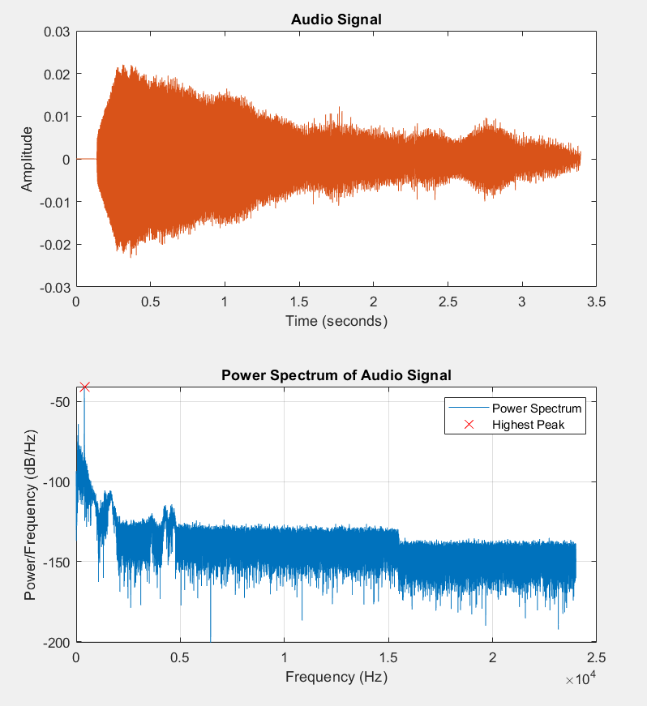

Slide 5
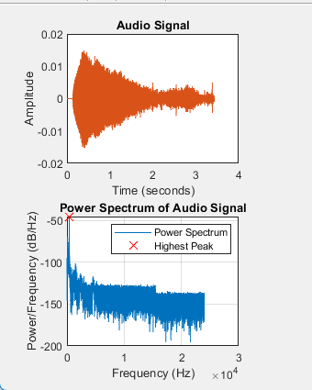


Slide 6
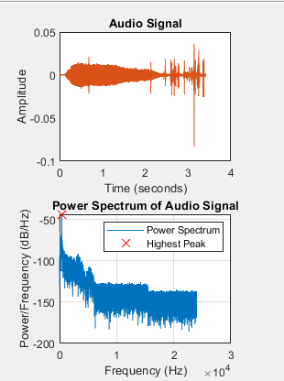


Slide 7
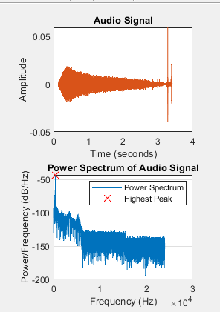

Slide 8
Fracture Samples

Slide 9
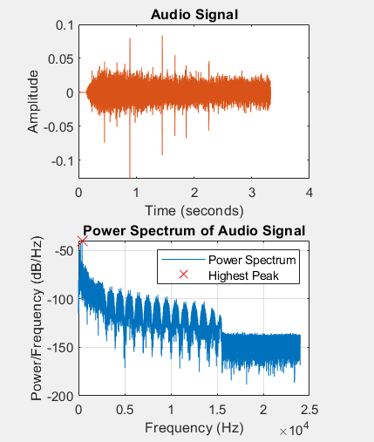


Slide 10
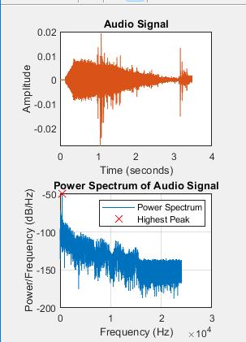

Slide 11
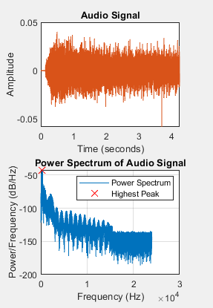

Slide 12
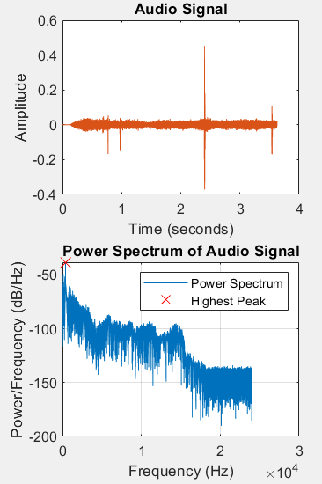


Slide 13
Results
Input Frequency
Condition of bone
Amplitude
Standard Deviation
8.2123e-05
3.4063e-07
2.88e-05
1.0871e-07
Healthy
4.5451e-05
1.7439e-07
5.3042e-05
1.9537e-07
512Hz
0.00010679
4.4458e-07
Fracture
1.4235e-05
5.4634e-08
5.0463e-05
2.7031e-07
0.00014681
6.822e-07

Slide 14
THANK YOU

